Slide 1

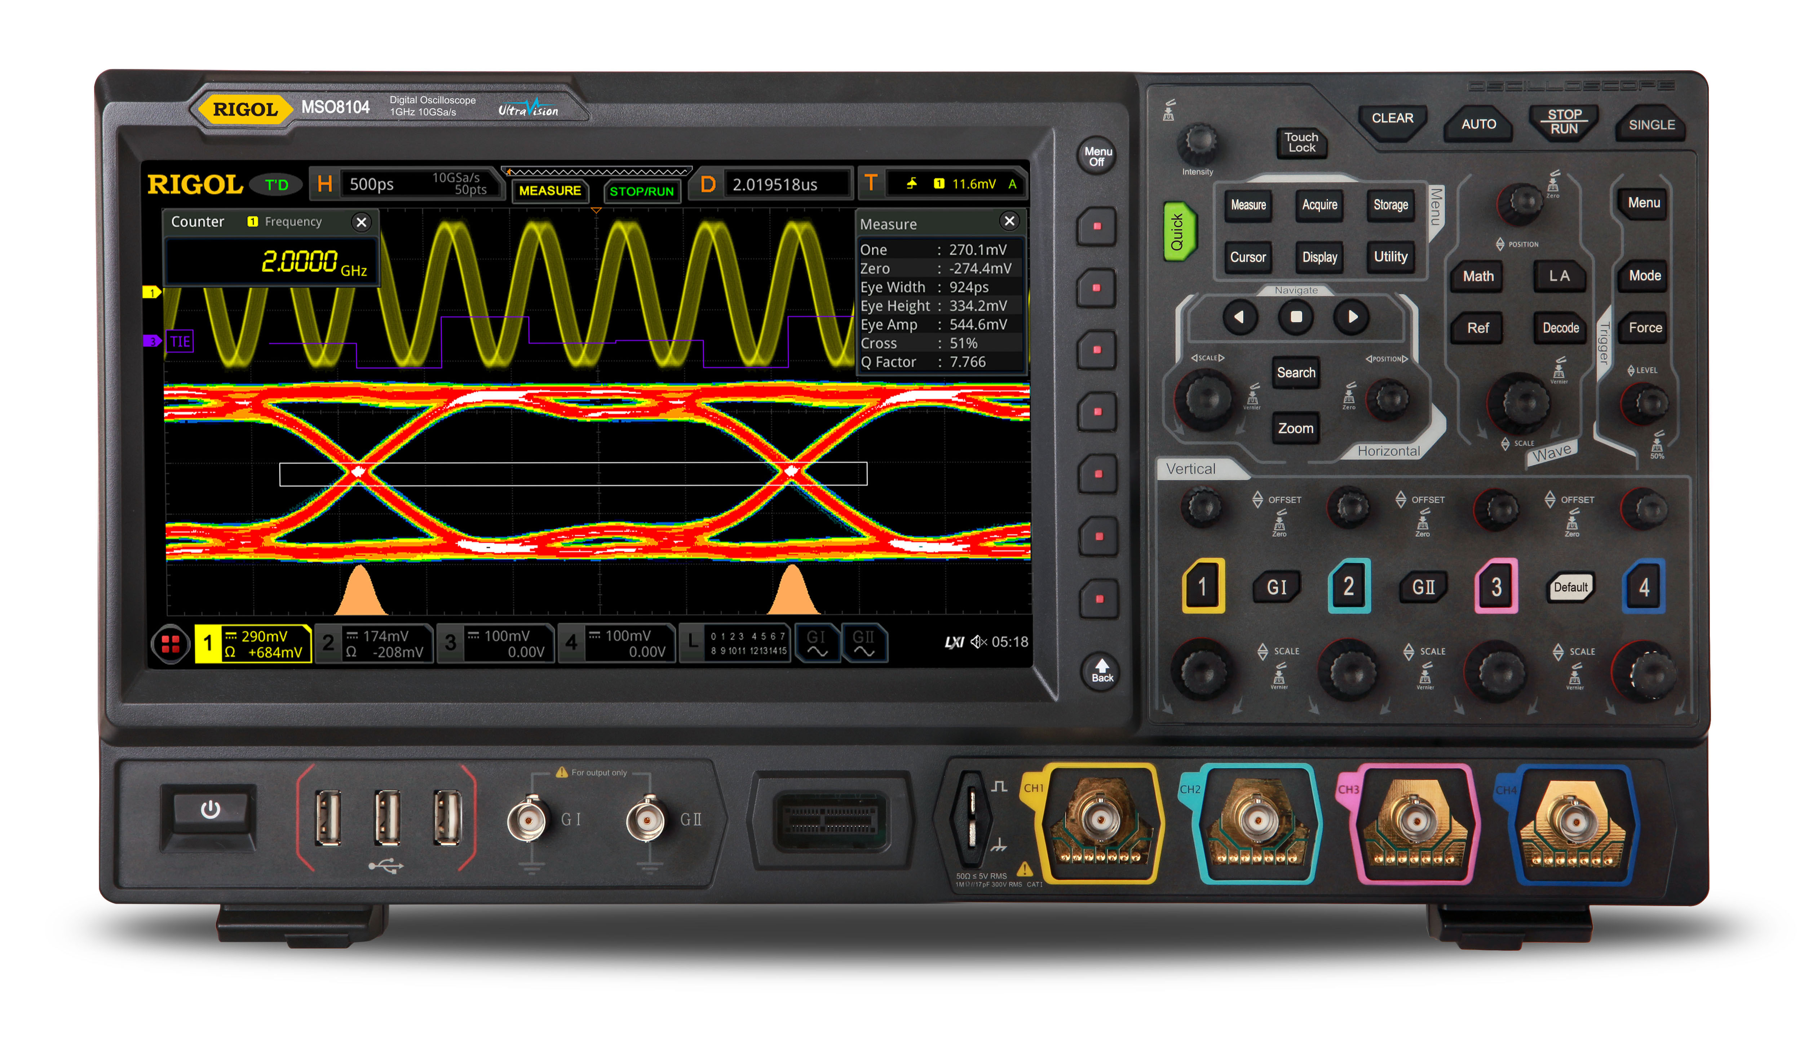
DBSP: A unified (practical) theory of databases, streams, and incremental computation
Mihai Budiu – feldera.com
Simons Institute
Industry Day
November 2, 2023

Slide 2
The gory details
Best paper award
DBSP: Automatic Incremental View Maintenance for Rich Query Languages Mihai Budiu, Tej Chajed, Frank McSherry, Leonid Ryzhyk, Val Tannen VLDB 2023, Vancouver, Canada

Slide 3

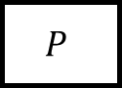
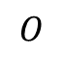
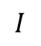
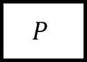
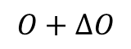
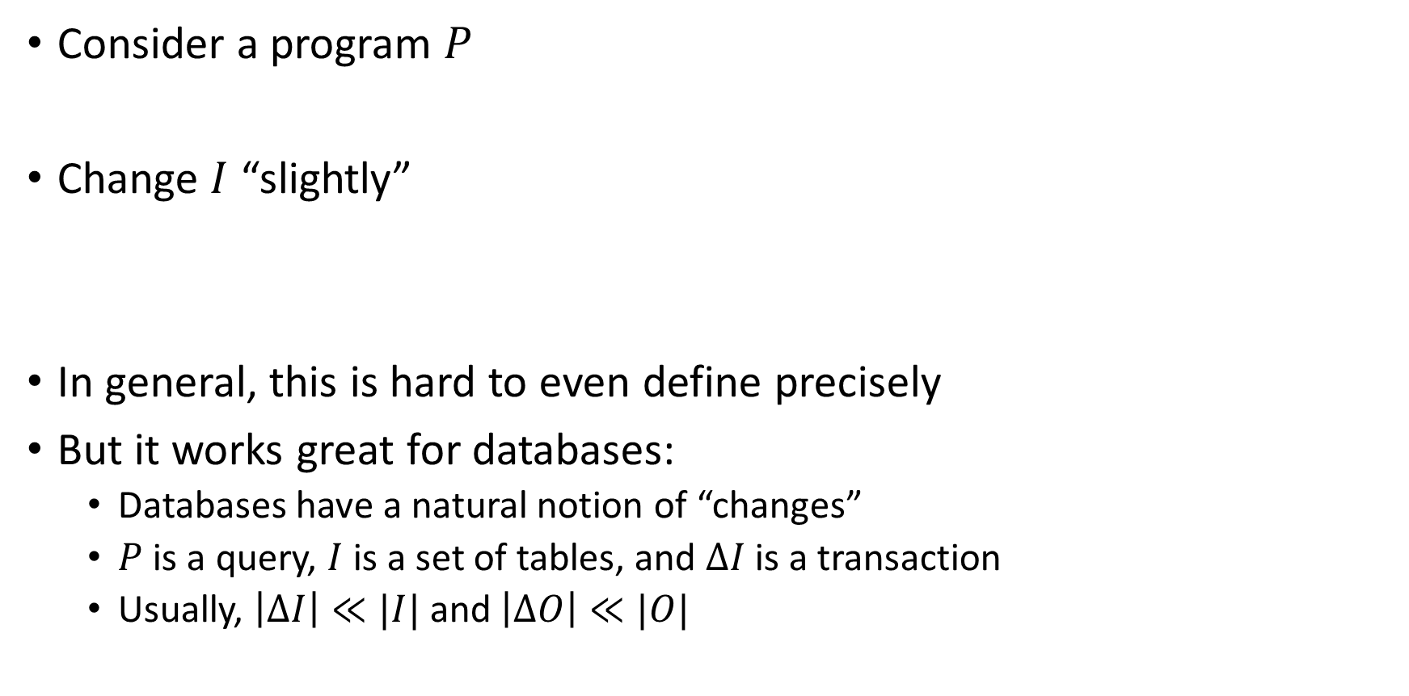
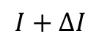
What is incremental computation?
Consider a program $P$
Change $I$ “slightly”
In general, this is hard to even define precisely
But it works great for databases:
Databases have a natural notion of “changes”
$P$ is a query, $I$ is a set of tables, and $ΔI$ is a transaction
Usually, $\left|ΔI\right|≪|I|$ and $\left|ΔO\right|≪|O|$
$$I$$
$$P$$
$$O$$
reuse
$$I+ΔI$$
$$P$$
$$O+ΔO$$

Slide 4
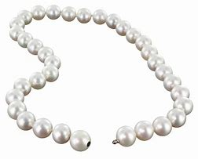
DBSP: A simple streaming language
Inspired by Digital Signal Processing
Four (4) operators
A new definition of incremental computation using streams
An algorithm converting an arbitrary DBSP program to an incremental DBSP program
A recipe implementing DB queries in DBSP
Corollary: incremental evaluation for arbitrary queries!

Slide 5


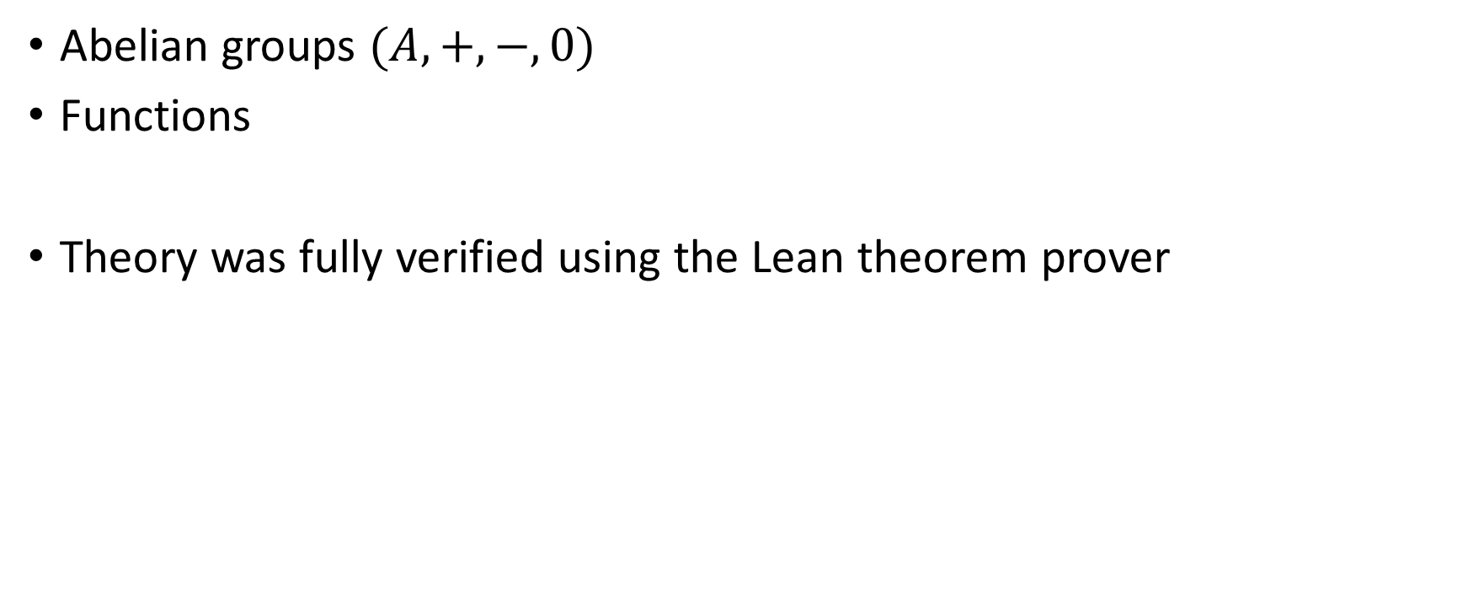
Basic Ingredients
Abelian groups $(A, +, −, 0)$
Functions
Theory was fully verified using the Lean theorem prover

Slide 6

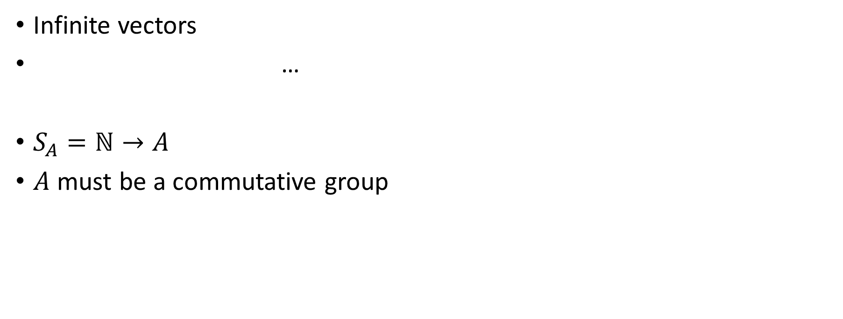
Streams
Infinite vectors
…
$S_{A}=ℕ→A$
$A$ must be a commutative group
0
1
2
1
0
-1
-2
-1
time

Slide 7
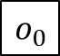
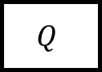
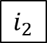
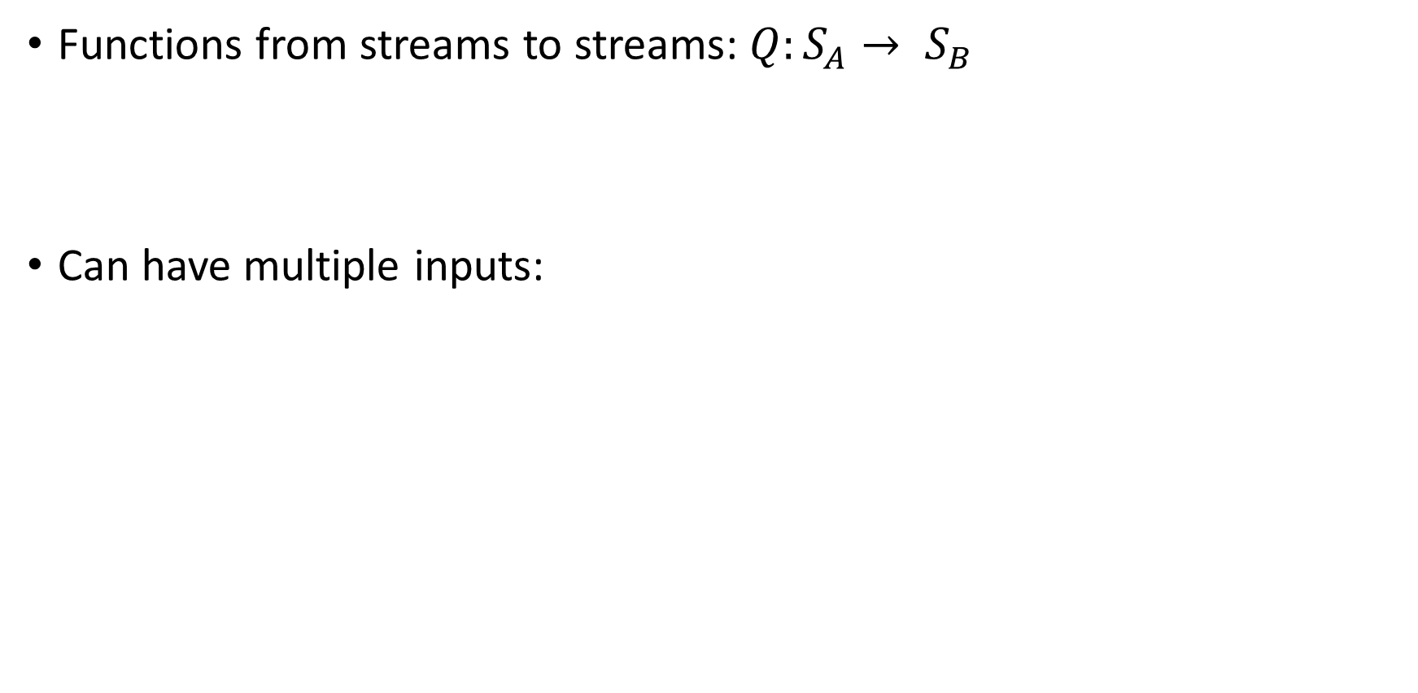
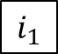
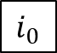
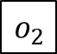
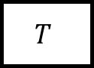
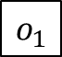
Stream operators
Functions from streams to streams:$Q:S_{A}→ S_{B}$
Can have multiple inputs:
$$i_{0}$$
$$i_{1}$$
$$i_{2}$$
…
$$Q$$
$$o_{0}$$
$$o_{1}$$
$$o_{2}$$
…
…
$$T$$
…
…

Slide 8
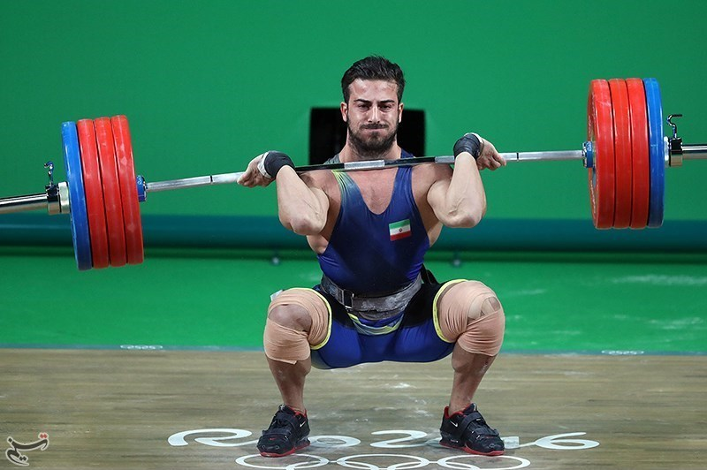
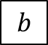
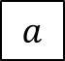
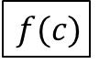
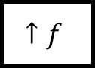
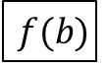
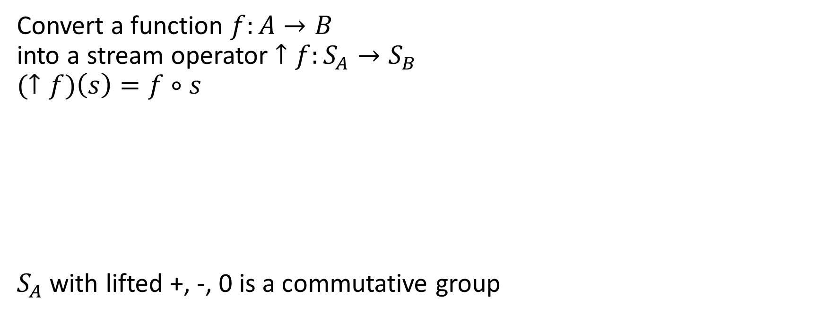
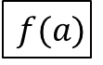
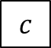
Lifting
Convert a function $f:A→B$ into a stream operator $↑f:S_{A}→S_{B}$
$$(↑f)\left(s\right)=f∘s$$
$S_{A}$ with lifted +, -, 0 is a commutative group
$$a$$
$$b$$
$$c$$
…
$$↑f$$
$$f(a)$$
$$f(b)$$
$$f(c)$$
…

Slide 9
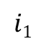
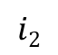
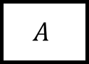
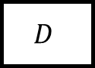
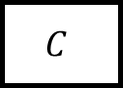
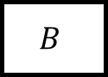
Chaining operators into circuits
Function composition
$$i1$$
$$A$$
$$B$$
$$C$$
o
$$i2$$
$$D$$

Slide 10
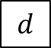
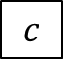
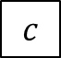

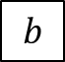
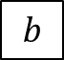
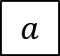
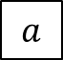
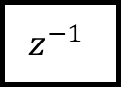

Delay ($z^{−1}$ )
Output is input stream delayed by one step
First value is 0
(Name comes from the Z-transform)
$$a$$
$$b$$
$$c$$
$$d$$
…
$$z^{−1}$$
$$0$$
$$a$$
$$b$$
$$c$$
…

Slide 11
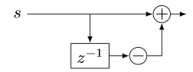
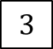
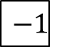
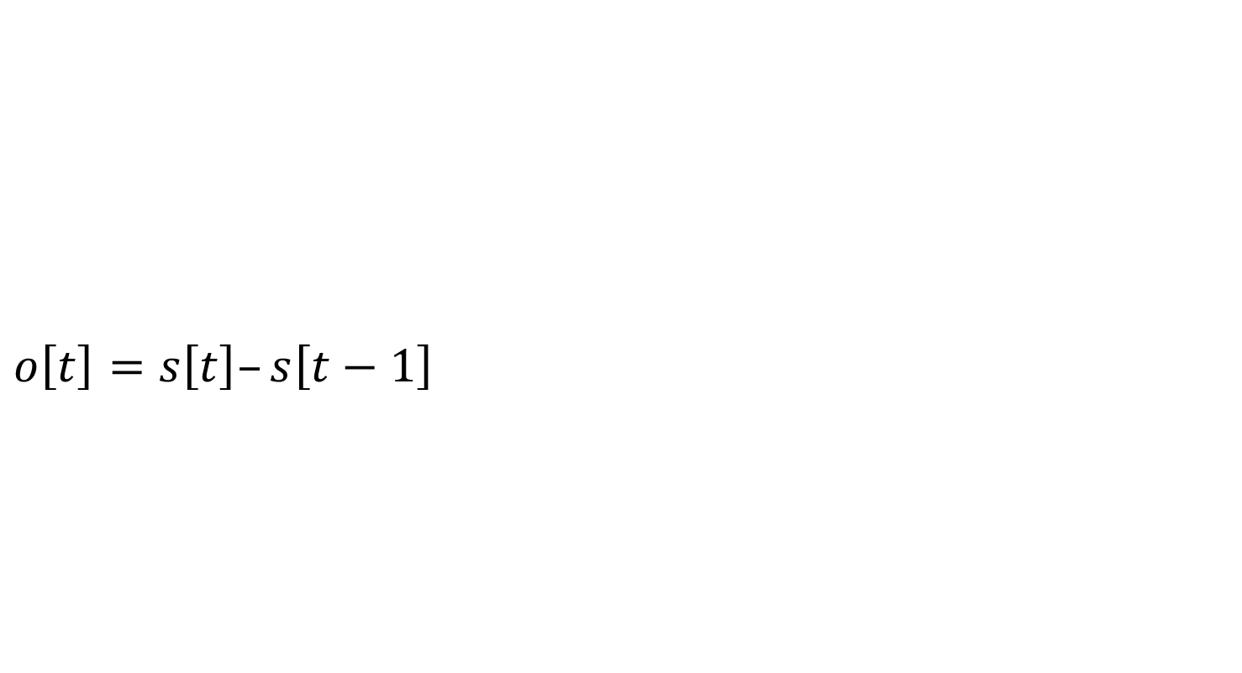

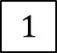

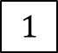

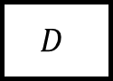



Discrete derivatives $ds/dt$
$$o\left[t\right]=s\left[t\right]–s\left[t−1\right]$$
$$D$$
o
o is the stream of changes of s
$$1$$
$$2$$
$$3$$
$$2$$
…
$$D$$
$$1$$
$$1$$
$$1$$
$$−1$$
…
stream of deltas

Slide 12












Discrete integration $\int_{0}^{t}{s\left(t\right)dt}$
$o[0] =s[0]$
$o[t] =s[t] + o[t−1]$
$o\left[t\right]=s\left[0\right]+s\left[1\right]+ …+s[t]$
$$I$$
o
If s is a stream of changes…
… then o is the original stream
$$1$$
$$1$$
$$1$$
$$−1$$
…
$$I$$
$$1$$
$$2$$
3
$$2$$
…
stream of changes

Slide 13



$D$ and $I$ are inverses
$$⇔$$
$$⇔$$

Slide 14










All databases are streaming databases!
Consider a database $DB$, a set of tables
A committed transaction is a change to $DB$
The set of linearized transactions define $T,$ a stream of changes to $DB$
$T[k]$is the $k$-th transaction
$DB$ is a stream of database snapshots
$DB[k]$ is the contents of the database after $k$ transactions have been committed
$DB[k] = I(T)[k$]
A database (stream) is the integral of a transaction stream
$$T_{0}$$
$$T_{1}$$
$$T_{2}$$
$$T_{3}$$
…
$$I$$
$${DB}_{0}$$
$${DB}_{1}$$
$${DB}_{2}$$
$${DB}_{3}$$
…

Slide 15












Database Views are lifted queries
Let $Q$ be a query defining a view $V$, e.g.:
CREATE VIEW V AS SELECT * FROM T WHERE Age >= 10
$V[k]=Q\left(DB[k]\right)$
$V$ is a stream of view snapshots:
$$V= ↑Q(DB)$$
$$↑Q$$
$$V_{0}$$
$$V_{1}$$
$$V_{2}$$
$$V_{3}$$
…
Versions of $V$
Versions of $DB$
$${DB}_{0}$$
$${DB}_{1}$$
$${DB}_{2}$$
$${DB}_{3}$$
…

Slide 16













Incrementally maintaining view $V$
Outputs can be small (they are deltas)
It is compositional: inputs and outputs are both changes
$${(↑Q)}^{Δ}$$
$$T_{0}$$
$$T_{1}$$
$$T_{2}$$
$$T_{3}$$
…
$$I$$
$$↑Q$$
D
$$ΔV_{0}$$
$$ΔV_{1}$$
$$ΔV_{2}$$
$$ΔV_{3}$$
…
Changes to $DB$
Changes to $V$
$$V_{0}$$
$$V_{1}$$
$$V_{2}$$
$$V_{3}$$
…
Versions of $V$
Versions of $DB$
$${DB}_{0}$$
$${DB}_{1}$$
$${DB}_{2}$$
$${DB}_{3}$$
…

Slide 17



Fundamental Equation of Incremental View Maintenance
$$Q^{Δ}=D∘Q∘I$$
As written, $Q^{Δ}$ is expensive
However, we can often optimize the computation
Notice: we don’t need to compute $\frac{dQ(s)}{ds}$
Only $ds/dt$

Slide 18






The chain rule
$$(Q_{2}{∘Q_{1})}^{Δ}=Q_{2}^{Δ}∘Q_{1}^{Δ}$$
Proof by pictures:
We can incrementalize a complex computation by incrementalizing each component independently
$$⇔$$
$$⇔$$
$$⇔$$

Slide 19




















Linear operators
For a linear stream operator $Q$ we have $Q=Q^{Δ}$
Original:
Optimized:
A speedup of $O(\left|DB\right|/|T|)$ !
$$T_{0}$$
$$T_{1}$$
$$T_{2}$$
$$T_{3}$$
…
$$I$$
$$Q$$
D
$$ΔV_{0}$$
$$ΔV_{1}$$
$$ΔV_{2}$$
$$ΔV_{3}$$
…
$$T_{0}$$
$$T_{1}$$
$$T_{2}$$
$$T_{3}$$
…
$$Q$$
$$ΔV_{0}$$
$$ΔV_{1}$$
$$ΔV_{2}$$
$$ΔV_{3}$$
…

Slide 20







Recursive functions
$$0, 0,0,0…$$
+
$$↑F$$
$$o$$
$$z^{−1}$$
$$o\left[n\right]=F\left(F\left(F\left(0\right)\right)\right) fix x.F(x)$$
$$n→∞$$
$n$ times
There is a version of the chain rule that works for recursive functions

Slide 21

Databases as abelian groups
Tables => $ℤ$-sets
Each row has an integer weight
Maps with finite support: $D→ ℤ$
Can represent
tables (multisets)
changes to tables
(Nested relations are $D→(D→ ℤ)$ )
Name | Age | Weight
Mike | 10 | 1
John | 12 | 3
Amy | 8 | -1
Chris | 10 | 2
tuples

Slide 22


We can use $ℤ$-sets to
Implement all of SQL
Efficient incremental versions of each operator

Slide 23

Does it work?
Open-source implementations:
DBSP runtime in Rust
Full SQL compiler
We founded inc. to develop this software stack

Slide 24

stream
DB
views

Slide 25
Extra slides

Slide 26










Incremental queries are streaming systems
$${Δi}_{0}$$
$${Δi}_{1}$$
$${Δi}_{2}$$
$${Δi}_{3}$$
…
$$Q^{Δ}$$
$$Δo_{0}$$
$$Δo_{1}$$
$$Δo_{2}$$
$$Δo_{3}$$
…
state
$Q^{Δ}$ is a streaming system:
it runs forever
it maintains internal state (even if $Q$ is stateless)
the state is stored in the delay operators (inside $I$ and $D$)

Slide 27









Linear operators: $Q(a+b) = Q(a) + Q(b)$
For a linear operator $Q$ we have $Q=Q^{Δ}$
Why is this better?
Optimized:
A speedup of $O(\left|DB\right|/|T|)$
$$T_{0}$$
$$T_{1}$$
$$T_{2}$$
$$T_{3}$$
…
$$I$$
$$Q$$
D
$$ΔV_{0}$$
$$ΔV_{1}$$
$$ΔV_{2}$$
$$ΔV_{3}$$
…
$${DB}_{0}$$
$${DB}_{1}$$
$${DB}_{2}$$
$${DB}_{3}$$
…
$$T_{0}$$
$$T_{1}$$
$$T_{2}$$
$$T_{3}$$
…
$$Q$$
$$ΔV_{0}$$
$$ΔV_{1}$$
$$ΔV_{2}$$
$$ΔV_{3}$$
…

Slide 28



Bilinear operators
(Lifted) join
From distributivity:$Δ\left(A×B\right)=\left(A×ΔB\right)+\left(ΔA×B\right)+\left(ΔA×ΔB\right)$
Speed-up is $O(\frac{\left|A\right|}{\left|ΔA\right|}+\frac{\left|B\right|}{\left|ΔB\right|})$
$$⇔$$

